Slide 1
Statistical Shape Analysis
Applications in orthopedics, and more…
* Images: Cates J, “Shape Modelling and Analysis with Entropy based Particle Systems,” PhD Thesis, University of Utah

Slide 2
Study of ‘Shape’
What questions can it answer ?*
Genetics
How does a gene mutation change skeletal development in mice?
Anthropology & Evolutionary Biology
How does bone shape vary in a fossil record?
Is the shape of a given bone a good classifier for species?
Neuroanatomy
Is there a difference in the shape of brain structures between schizophrenic and normal populations?
Biomechanics
What is the normal covariation in shape of structures of the hip joint?
How does it change as a function of age?
Notes:
Overview of the kind of questions that statistical shape analysis can answer… picked from the various use-cases we have had so far.
This can be the motivation to do statistical shape analysis…

Slide 3
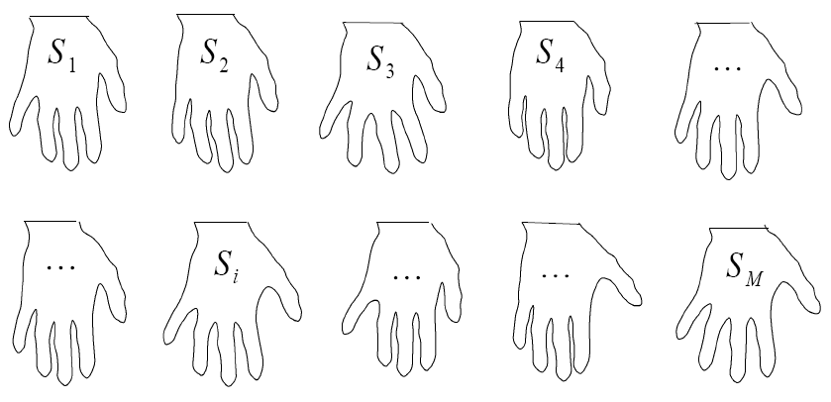
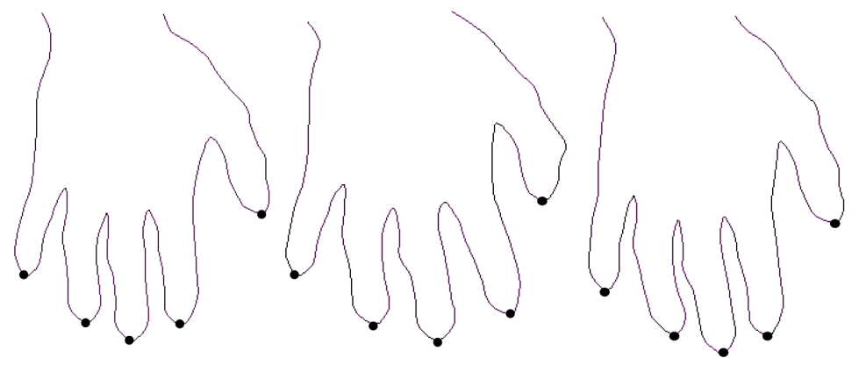
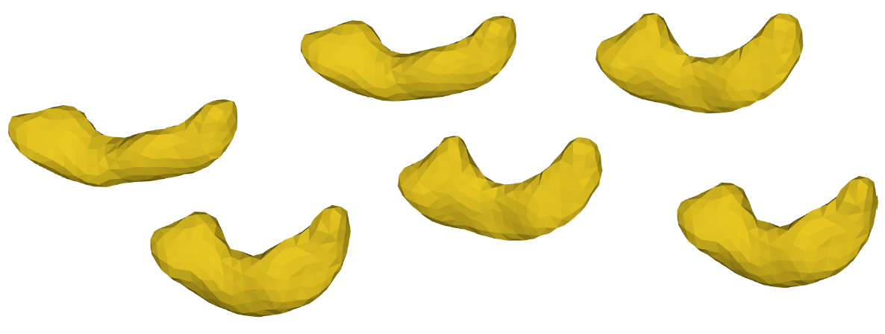
Statistical Shape Analysis
It’s all about representation…
Given a collection of shapes, we can use a point based representation for each S_{i}
BUT…
How do we choose the “same” points ??
Notes:
To study shape, it is important to come up with a compact representation, and this representation should be consistent across dimensions. Point based representation is an important representation to consider, and this is the one we use in ShapeWorks

Slide 4
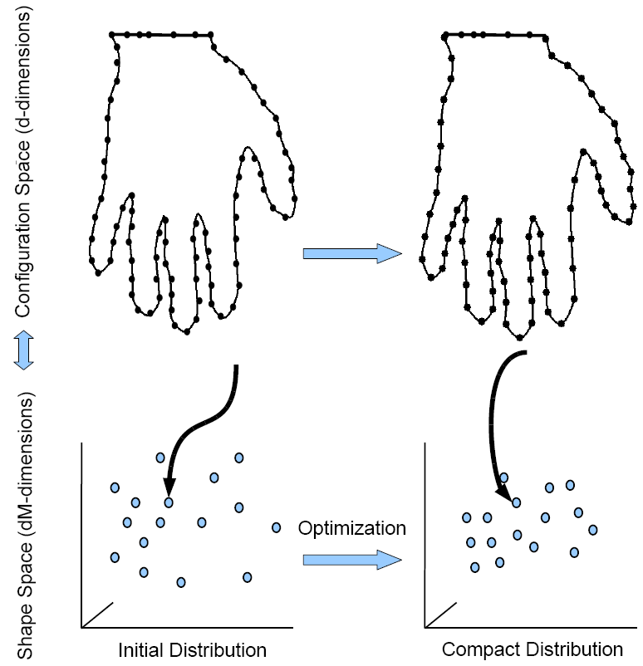
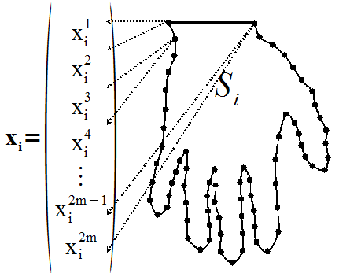
Point Correspondence Model Balancing accuracy vs. low variance
Shape Representation*
Shape Correspondence*
Configuration Space (d-dim) S_{i} -> (x_{i}¹ , …, x_{i}^{2M}) x_{i} -> d-dimensional point
Shape Space (dM-dim): S_{i} -> single point !
Trade off: accurate sampling vs. compact model
Notes:
Explain basic correspondence model, trade-off between surface sampling energy and correspondence energy. Also state that the end-result is a point-representation for each shape, where the points are in correspondence across shapes.
This balance is achieved via gradient descent optimization of particle positions using a cost function based on entropy.

Slide 5
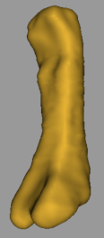
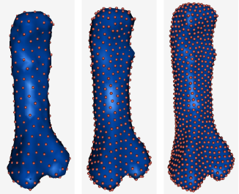
Correspondence Pipeline*
Notes:
Describe the steps involved in the process, before delving into the orthopedics applications

Slide 6
ShapeWorks for Orthopedics

Slide 7
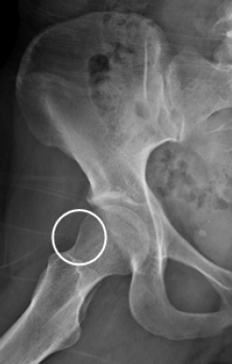
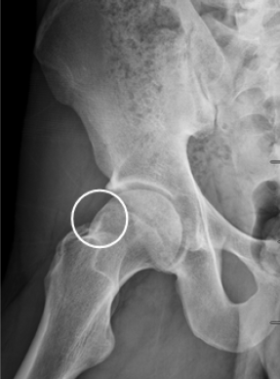
FAI Characterization† Dr. Jeffery Weiss, Dr. Andrew Anderson, clinicians @ Orthopedics Department of Orthopedics, University of Utah
Fig: Radiographs of subjects with healthy (left) and cam FAI (right) femurs. Circles indicate the anterolateral head-neck junction.
Objective: quantify 3D variation and morphologic differences between control and cam femurs
†MD Harris, M Datar, E Jurrus, CL Peters, RT Whitaker, AE Anderson, "Statistical Shape Modeling of CAM-type Femoroacetabular Impingement CMBBE 2012
Notes:
Femoroacetabular impingement is a recently described disease of the hip that is marked by reduced clearance between the femoral head and acetabulum due to morphologic abnormalities of the femur (termed cam FAI), acetabulum (termed pincer FAI), or both (termed mixed FAI)1. Cam FAI is caused by a bony lesion on the femoral head or reduced concavity in the femoral head-neck junction, which may cause shearing between the femur and acetabulum thereby damaging articular cartilage and the acetabular labrum
Currently, diagnosis of cam FAI is largely done using 2D radiographic measurements of femur morphology and do not provide quantitative information that translates well for preoperative planning
If physicians could be provided with knowledge of the size and shape of a cam lesion, a more exact diagnosis, as well as detailed preoperative planning, may be facilitated.

Slide 8
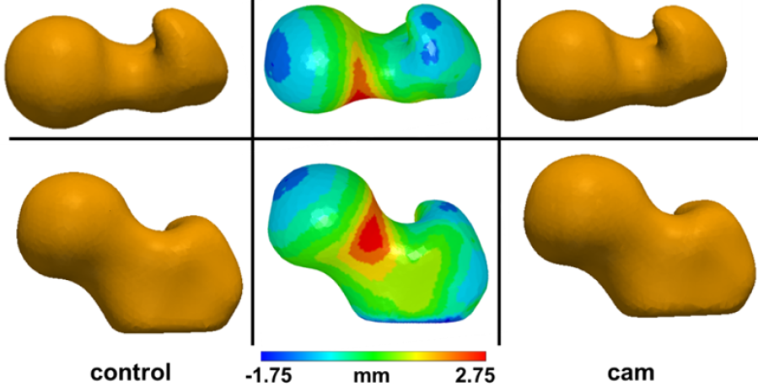
FAI Characterization† Dr. Jeffery Weiss, Dr. Andrew Anderson, clinicians @ Orthopedics Department of Orthopedics, University of Utah
Fig: Two views (two rows) of the mean control (left) and cam (right) shapes. Mean control shape (center), color coded to depict shape differences in comparison with mean CAM shape
Segmented femurs from controls (33) and patients(15) with CAM-FAI
Statistically significant group differences (p-value < 0.01)
Mean shape deviations between control and CAM groups most pronounced at the anterolateral head-neck junction (max = 2.7mm)
†MD Harris, M Datar, E Jurrus, CL Peters, RT Whitaker, AE Anderson, "Statistical Shape Modeling of CAM-type Femoroacetabular Impingement CMBBE 2012
Notes:
Do we need a slide showing the ShapeWorks pipeline before this one ?

Slide 9
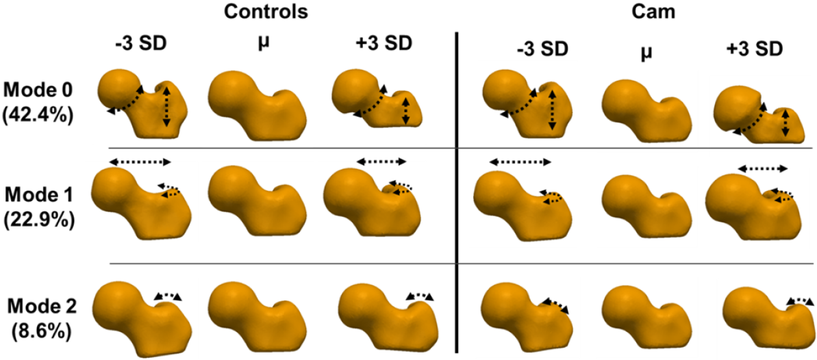
FAI Characterization† Dr. Jeffery Weiss, Dr. Andrew Anderson, clinicians @ Orthopedics Department of Orthopedics, University of Utah
Fig: Mean shapes (μ) for both groups and shapes at ±3 standard deviations for the first 3 modes
Consistent differences captured by individual modes for control and CAM groups
†MD Harris, M Datar, E Jurrus, CL Peters, RT Whitaker, AE Anderson, "Statistical Shape Modeling of CAM-type Femoroacetabular Impingement CMBBE 2012
Notes:
Mode 0: variation in head-neck concavity, distance between trochanters
Mode 1: neck extension and anteroposterior curvature of the greater trochanter
Mode 2: coronal curvature of the greater trochanter

Slide 10
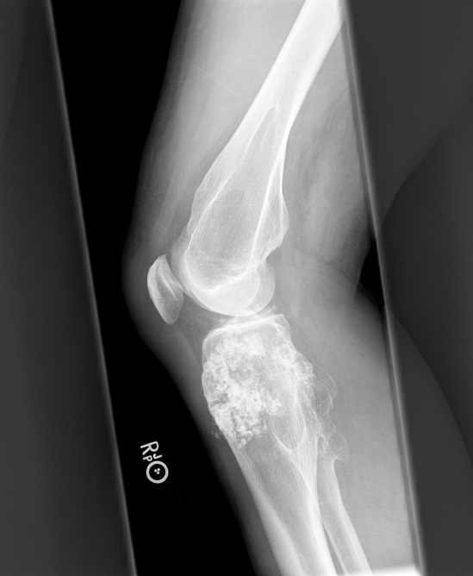
Mouse Model of Osteochondroma Dr. Kevin Jones, M.D., clinicians @ Huntsman Cancer Institute Department of Orthopedics and Huntsman Cancer Institute, University of Utah
Individuals with multiple osteochondromas (MO) demonstrate shortened long bones. Possible reason: steal phenomenon
Segmented bones (femur, tibia+fibula) from mice, genetically altered to inflict osteochondroma at various stages in time
Histopathology image of MO in mice bone
Segmented femur and tibia+fibula used in study
MO in human bone
Notes:
Loss of heterozygosity for Ext1 (a mutation in this gene is the cause of the cencer) may induce shortening by steal of longitudinal growth into osteochondromas.
Bone lengths and volumes were compared. Metaphyseal volume deviations from normal, as a measure of osteochondroma volumetric growth, were
correlated with length deviations.

Slide 11
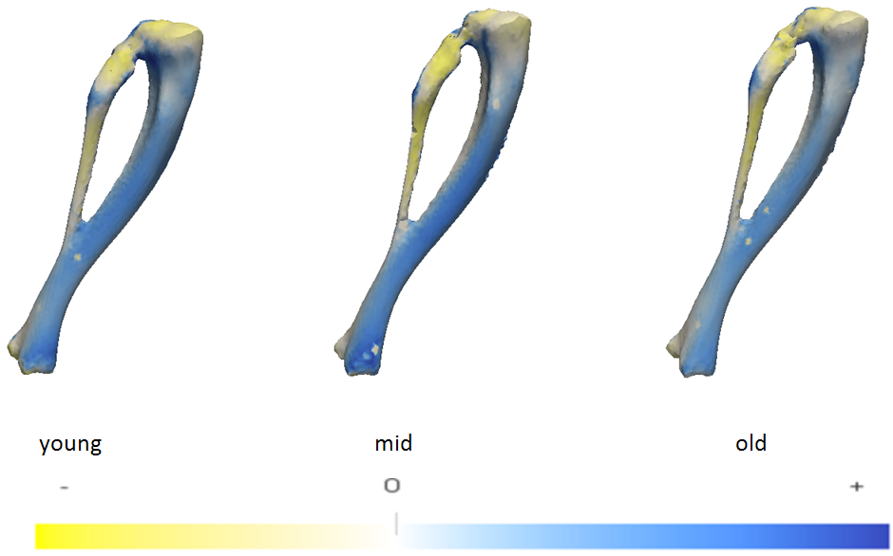
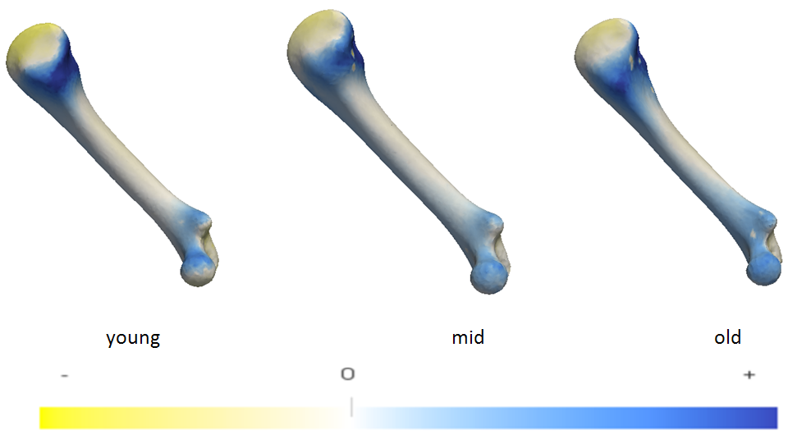
Mouse Model of Osteochondroma Dr. Kevin Jones, M.D., clinicians @ Huntsman Cancer Institute Department of Orthopedics and Huntsman Cancer Institute, University of Utah
Fig: Group mean differences for femur
Fig: Group mean differences for tibia+fibula
Color code: expansion (blue) or contraction (yellow) w.r.t normal
Statistically significant group differences (individual p-values < 0.01)
Correlation with length evident visually in the group means
Next step: Directional analysis
Notes:
Population analysis was done on 3 pairs: normal+young_dox, normal+mid_dox, normal+old_dox.
Femur
Parallel analysis found 5 significant modes of variation for each pair of groups. The group differences between all pairs using these 5 modes were significant with a p-value < 0.01
Tibia+fibula
Parallel analysis found 4 significant modes of variation for each pair of groups. The group differences between all pairs using these 4 modes were significant with a p-value < 0.01
Summary of results:
MO mice had shorter femora and tibiae than controls, more pronouncedly when osteochondromagenesis was induced earlier during skeletal growth. Volumetric osteochondroma growth did not predict longitudinal shortening, rather inversely correlating with it.

Slide 12
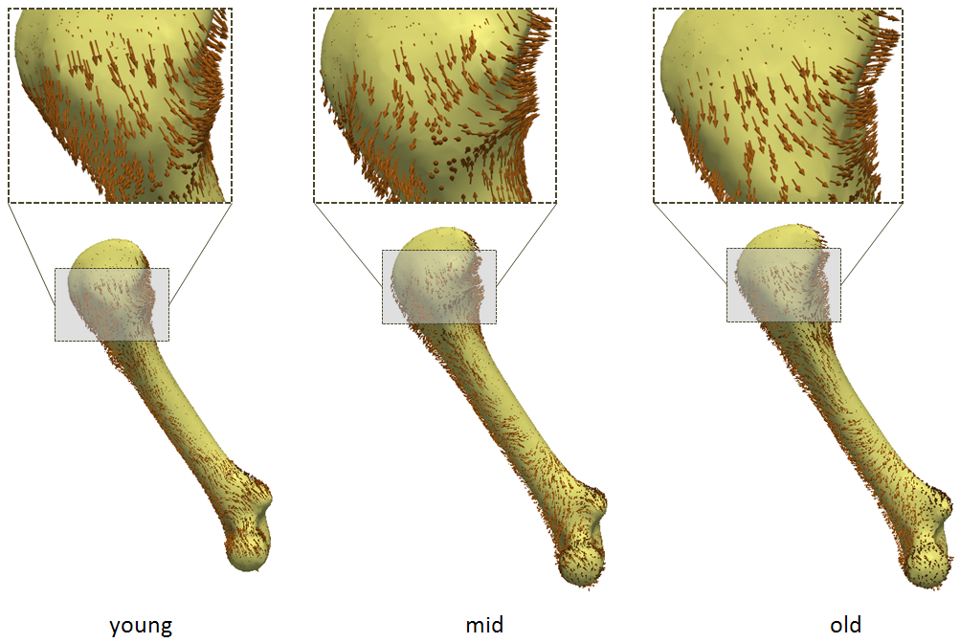
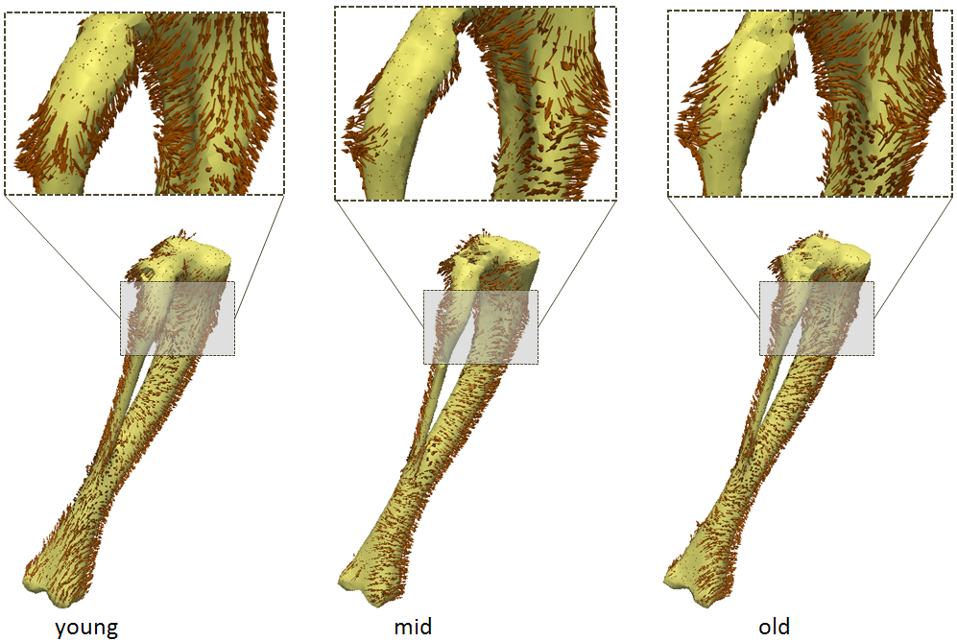
Mouse Model of Osteochondroma Dr. Kevin Jones, M.D., clinicians @ Huntsman Cancer Institute Department of Orthopedics and Huntsman Cancer Institute, University of Utah
Fig: Directional analysis for femur
Fig: Directional analysis for tibia+fibula
Arrows show local deformation from mean-normal to mean-mutant shape
Gives visual indication of the steal phenomenon, with:
Tangential deformation in most areas of the mean shape, leading to shortening in length
Orthogonal deformation near “bumps”, leading to local increase in girth
Next step: Quantifying differences for individual subjects
Notes:
Need to describe this analysis a little better…

Slide 13
Summary
Notes:
Razzmatazz… should this be a part of the case study slides, or the tutorial slides ?

Slide 14
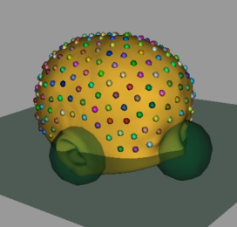
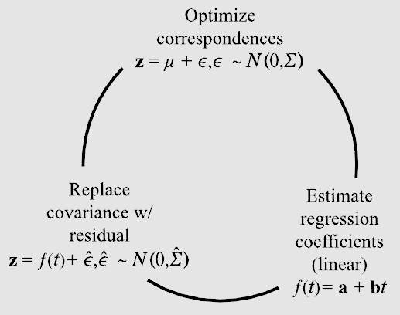
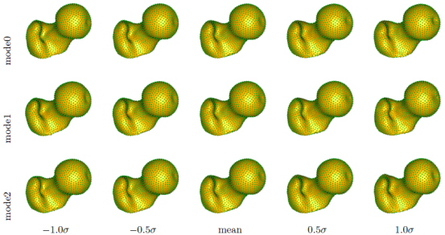
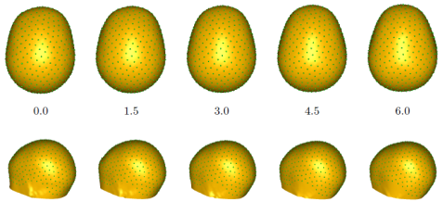
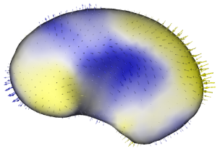
ShapeWorks Pipeline
Input Segmentation* | Distance Transform* | Antialiased Surface*
Preprocessing
Entropy Minimization* | Open Surfaces | Linear Regression
Optimization
Modes of Variation | Group Differences* | Regression Shape
Visualization

Slide 15
Thank you !
Questions ?

