Slide 1





Cleaver
A new tetrahedral mesher.

Slide 2
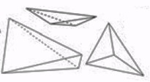
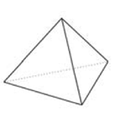
Landscape
BioMesh3D
  State of the start
  Adaptive
  Mostly good quality elements
  May produce degenerate elements
  Variational / Computational Expensive
  Unstructured Meshes
Cleaver
  No degenerate elements.
  Bounded worst-case element quality
  Guarantees on conformity / fidelity
  Structured
  Fast
Notes:
Juxstapose BioMesh3D with Cleaver
The motivation behind developing cleaver was to fill a gap in needs of users of BioMesh3D.
BioMesh3D offers conforming meshes for multimaterial data, and produces
Unstructured meshes of mostly good quality. Unfortunately, the variational nature of this
Algorithm is computationally expensive and is not guaranteed to produce meshes free
of degenerate elements. It has been shown that the quality of elements effect the conditioning
of matrices and can degrade or even break the results of simulations.
Cleaver is the other side of the coin. Using a background structure, it blazes through and
Uses a set of stencils to fill in the volume, conforming to topology to an approximation
while guaranteeing to never produce degenerate elements.

Slide 3
Element Quality
Dihedral Angles
Condition Number
Notes:
Element quality was the primary motivation for producing cleaver.
One metric for tetrahedral element quality is dihedral angle. This
Is the angle between planar faces of the tetrahedra. Cleaver allows
us relax the restriction on quality, producing tets of arbitrarily bad
Elements if we so desire. We used this to empirically evaluate the
claims of about mesh quality. The plot here shows that as the
Minimum dihedral angle in a mesh decreases, we see a logarithmic
Increase in the conditioning of the stiffness matrix of the assoicated
FEM solution. Eventually, this conditioning becomes so bad the
Solution is beyond floating point precision, and solutions can no
longer be trusted.

Slide 4
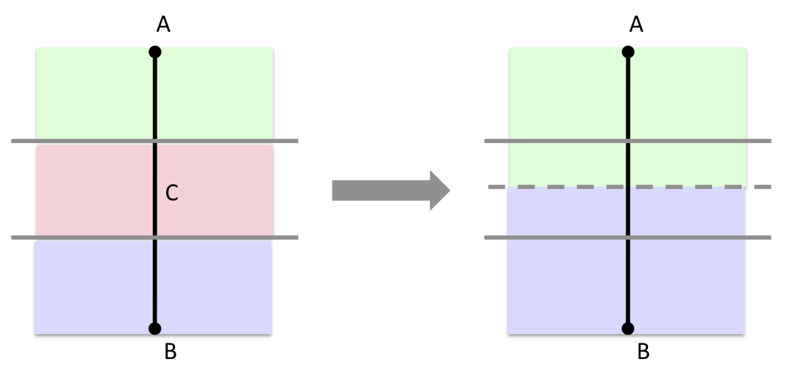
Multi-Material Challenges
Higher dimensional features
Interfaces may form sharp cusps
Complexity of cases
  Arbitrarily many cases even with linear elements
  Not all representable
  Snaps/warps more constrained
Notes:
To understand why BioMesh3D and Cleaver are unparalleled in implementation, it’s worth
looking at what makes the multimaterial meshing problem so difficult. Multiiple materials
Meet at smooth surfaces, but also at disjoint lines and cusps. Capturing these locations
Accurately with finite elements imposes tough constraints that modern meshing algorithms
have simply been unable to handle well. BioMesh3D handles these sharp cusps by adaptively
Producing smaller elements near these regions. This is the strength of the variational method,
And also one of the major contributors to how long it takes to run.
On the other side of the spectrum, Cleaver makes simplifying assumptions to get around this
Problem. The user specificies an input resolution at which they demand features be resolved.
Below this resolution, topological simplifications are used to limit the number of cases to a
Reasonable amount, while still achieving guarantees for conforming to the surface. In this
way, cleaver can very quickly produces high quality meshes with guarantees.

Slide 5
Cleaver
Based on Lattice Cleaving algorithm
  "Lattice Cleaving: Conforming Tetrahedral Meshes of Multimaterial Domains with Bounded Quality”
  Bronson, J., Levine, J., and Whitaker, R.
  To appear in Proceedings of the 21st International Meshing Roundtable (San Jose, CA, Oct 7 - 10, 2012)
Combinatoric (not variational)
  Background mesh (structured)
  Stencils to capture surfaces
Inherent Tradeoff
  Deforming background grid (small deviations)
  Cutting / Subdividing (large deviations)
Notes:
Cleaver is a first implementation of the Lattice Cleaving algorithm developed at the SCI institute.
by Jonathan Bronson under supervision of Professor Ross Whitaker and Postdoctoral Fellow Joshua Levine
The publication can be found in the proceedings of the 21st International Meshing Roundtable.
The algorithm is combinatoric, looping through a structured background mesh, filling in stencils of various
Types to accurately capture surface interface topologies. To ensure element quality, decisions are made
on when to deform the background mesh, when to simply stencil it, and when to do both.

Slide 6
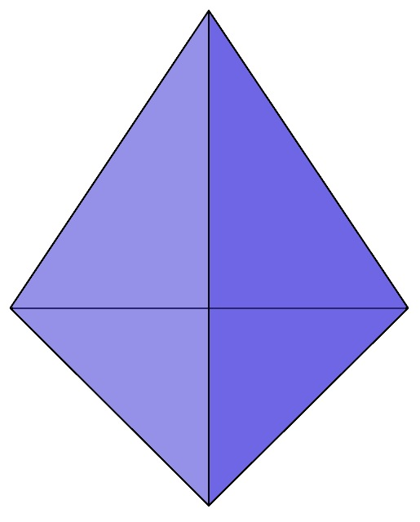
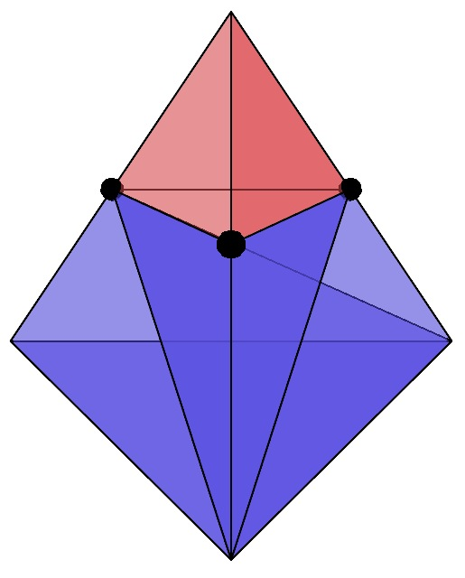
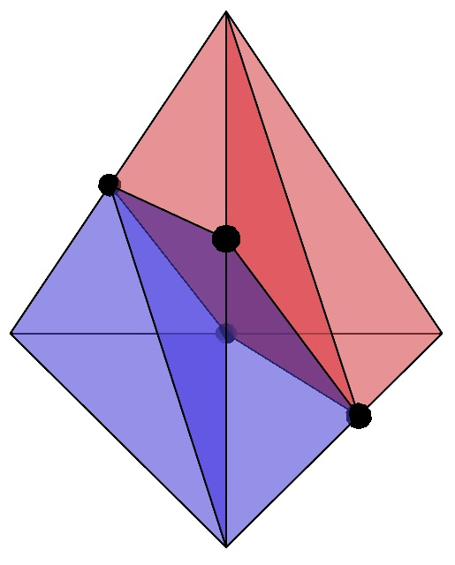
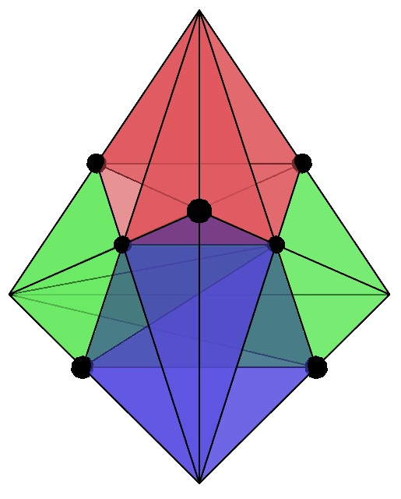
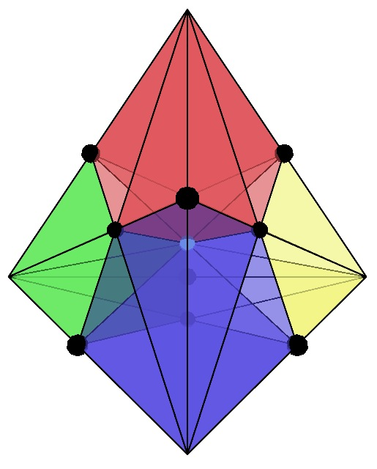
Stencils
Background lattice composed of tetrahedra which are ‘cleaved’ into various stencils.
These stencils locally capture various topologies
Notes:
Only a single material transition is allowed on a background mesh edge.
In this way, we simplify the number of topological cases to a reasonable amount.
Throughout the algorithm, we may warp the background grid to create additional
Topologies that lie between these. These cases are all handled by the same
Stencil set.

Slide 7
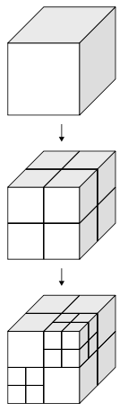
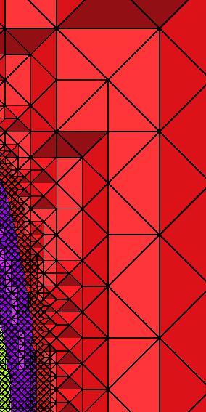
Graded Background
Octree Structure
Background Stencils
Notes:
The Bakground Lattice we use enables us to created graded meshes through the use of
an octree. Leave nodes of the tree contain lattice cells with material transitions. Homogeneous
Regions of the volume can be filled with increasingly larger stencils to reduce the overall
element count of the mesh.

Slide 8
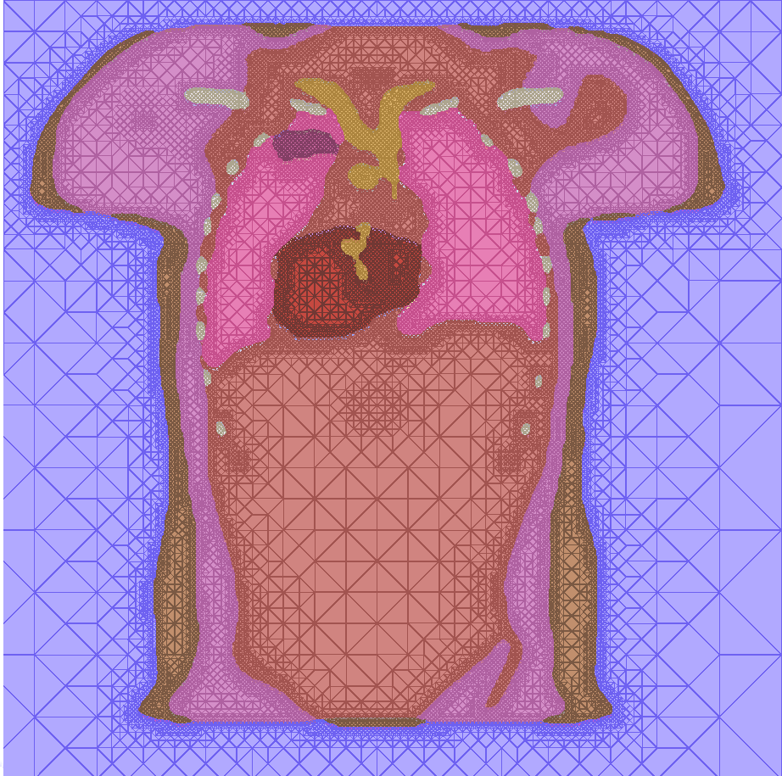
Notes:
Here are two examples of meshes we created. The primary focus
Here is the graded nature of the meshes in the surrounding air.

Slide 9
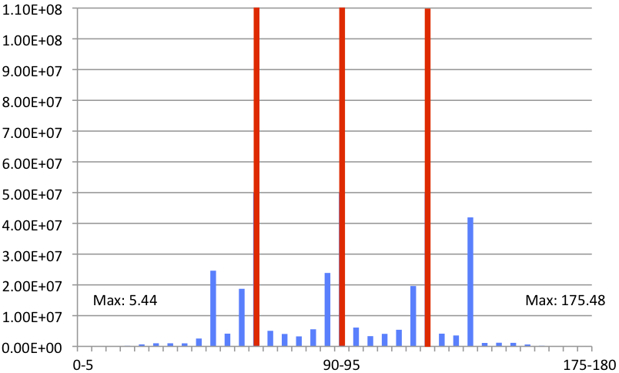
Dihedral Angles
Min
Min: 2.76
Max: 175.42
Notes:
The lattice cleaving algorithm cleaver is based on has a proof of mesh qualitiy, but
The exact bounds on dihedral angles is not known. Empirically evaluating thousands
of meshes for simulation data, the authors found the bounds to be as shown. Comparing
These values to the conditioning scale we saw earlier, these numbers are well within
range to achieve stable results in FEM simulations.

Slide 10
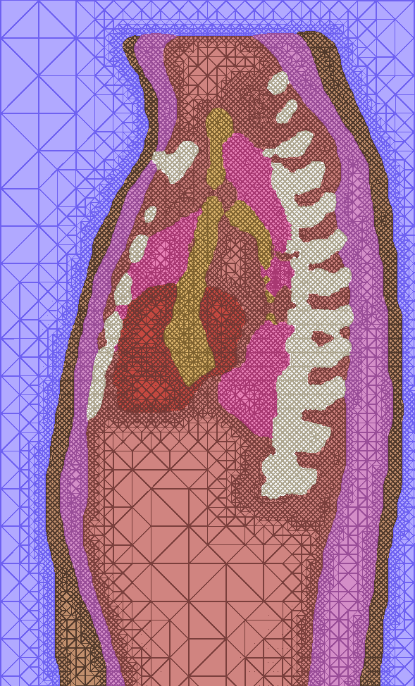
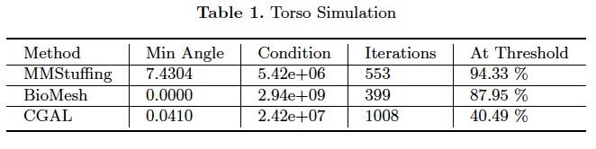
Cleaver
Notes:
A number of simulations were ran to evaluate the quality of Cleaver vs other standardly
used meshing softwares, including BioMesh and CGAL. CGAL is a computational
Geometry library developed by the meshing community, implementing variations of
Delaunay meshing.
Things to focus on here are that in this case, Cleaver produced vastly better element quality.
As a result, Cleaver had better conditioning than CGAL and BioMesh, and led to more reliable
results. In this case, more of the heart was rated as reaching the defibrillation voltage specified
In the experiment.

Slide 11
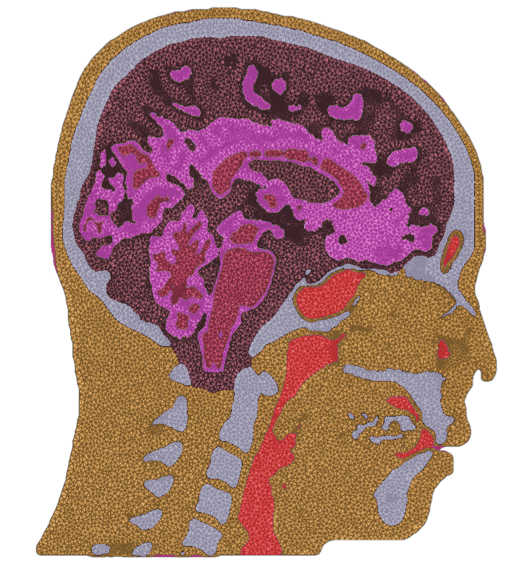

Evaluation (Qual.)
BioMesh3D
Cleaver
Notes:
This is a qualitative comparison of the meshes produced by BioMesh and Cleaver.
Notice that BioMesh provides in general smooth grading in regions of homogenity,
Which may be hard to control.
Cleaver on the other hande produces high levels of grading in regions of
Homogeneity. Depending on the type of simulation you need to run, one
Might choose either one over the other.

Slide 12
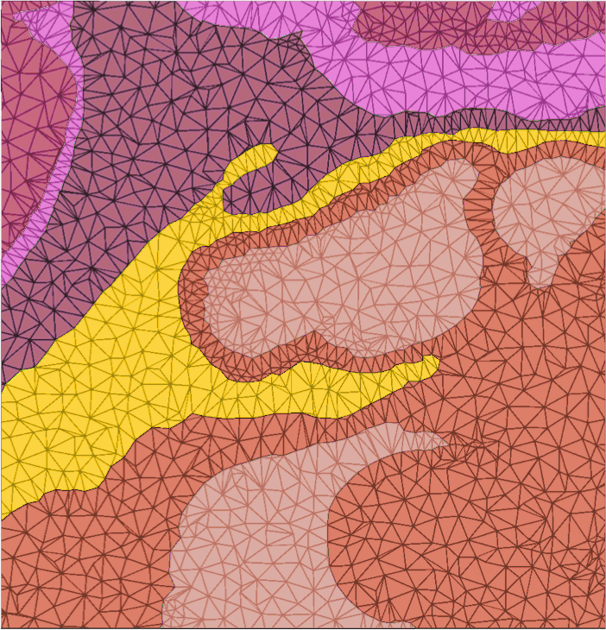
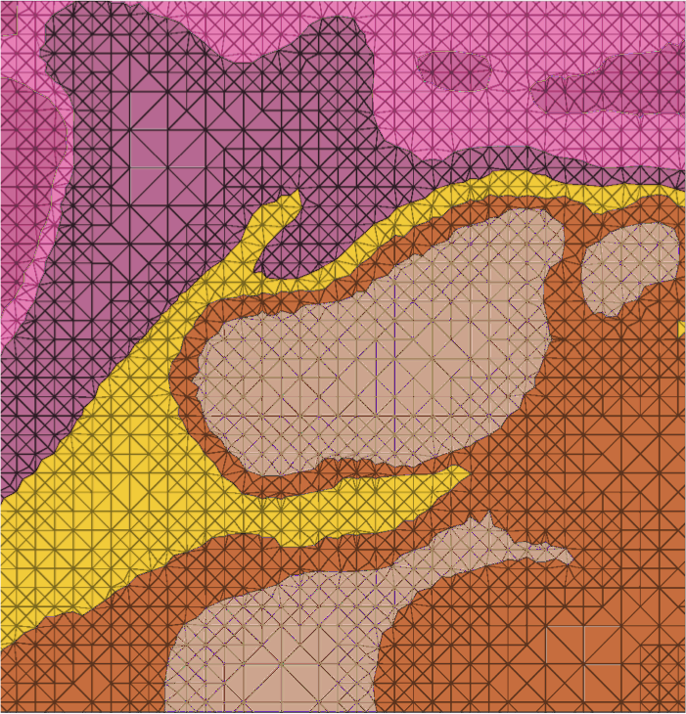
Evaluation (Qual.)
BioMesh3D
Cleaver
Notes:
Here is a close up view of the brain meshes generated by BioMesh3D and by Cleaver.
These images are not at exactly the same cross section, so do not focus on which features
Appear in one vs the other. Instead, focus on how the meshes are represented, especially
Near surface boundaries, as well as away from surface boundaries. Unstructured vs Structured.

Slide 13
Notes:
Example mesh.

Slide 14
Notes:
Example mesh.

Slide 15
Notes:
Example mesh.

Slide 16
Notes:
Example mesh.

Slide 17
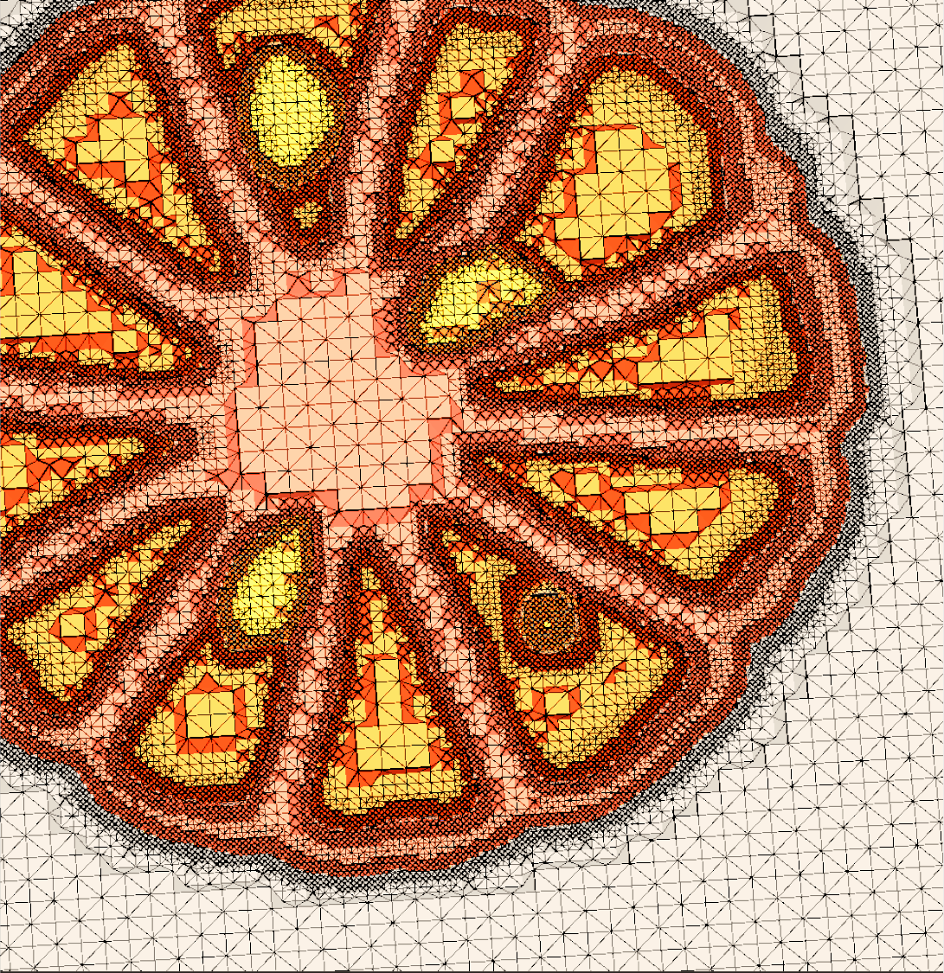
Notes:
Example mesh.
CT of Orange.
Notice divison of orange, and seeds.

Slide 18
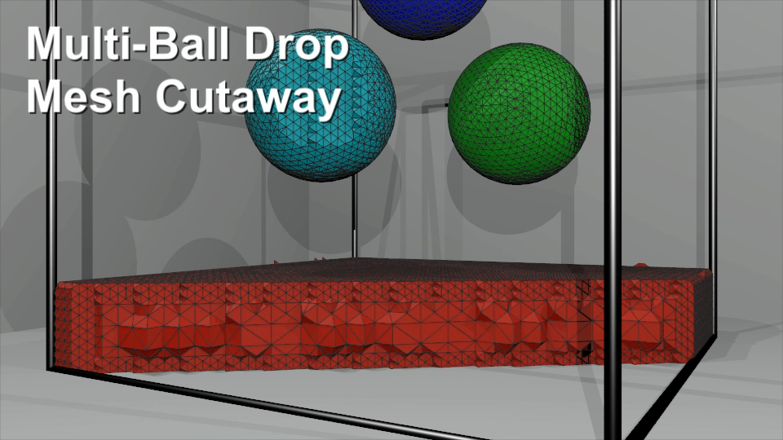
Other Domains
Notes:
Early work on a multimaterial fluid simulation.
Talk to Josh about getting a more up to date
Video of this.

Slide 19
Cleaver
First Release: Fall 2012
Features
  Incredibly fast
  Conforming
  Guarantees on Quality
  Input support
    SCIRun NRRD format
  Output supports
    SCIRun pts/elems
    Tetgen node/eles
    MATLAB Binaries
Notes:
Final information.
Optimistically this might be released in stand-alone form in Late October, 2012.
It will support the SCIRun NRRD input format, as well as several output formats.

