Slide 1
Cleaver A tetrahedral meshing tool.
Jonathan Bronson
SCI Institute

Slide 2
Cleaver
Multimaterial
Volume
Conforming
Tetrahedral Mesh

Slide 3
Input Representation
Two material interfaces:
Isosurface: level set of a continuous scalar function in 3D
Multi-material interfaces:
??
Indicator functions
One indicator function for each material
Scalar value indicates strength/contribution of material
Examples:
Distance Transforms
Partial Mixture Models

Slide 4
Input Format
Teem’s Nearly Rasterized Raw Data format (NRRD)
Seg3D Compatible
Human Readable Headers
http://teem.sourceforge.net/nrrd/index.html

Slide 5
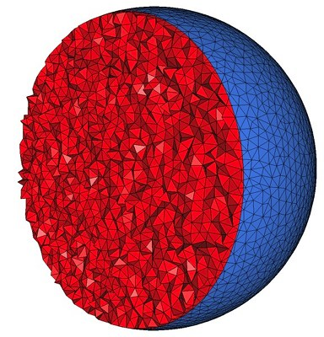
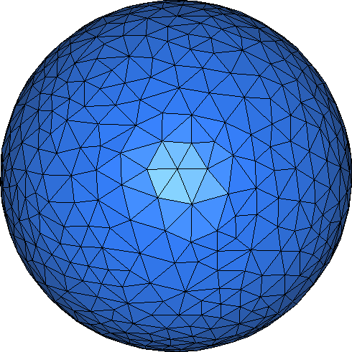
Output Formats
Tetrahedral Meshes
TetGen format (*.node, *.ele) - ASCII
Matlab format (*.mat) - Binary
Triangle Surface Meshes
PLY format – Stanford Triangle Format - ASCII

Slide 6
Cleaver 1
http://www.sci.utah.edu/software/cleaver.html

Slide 7
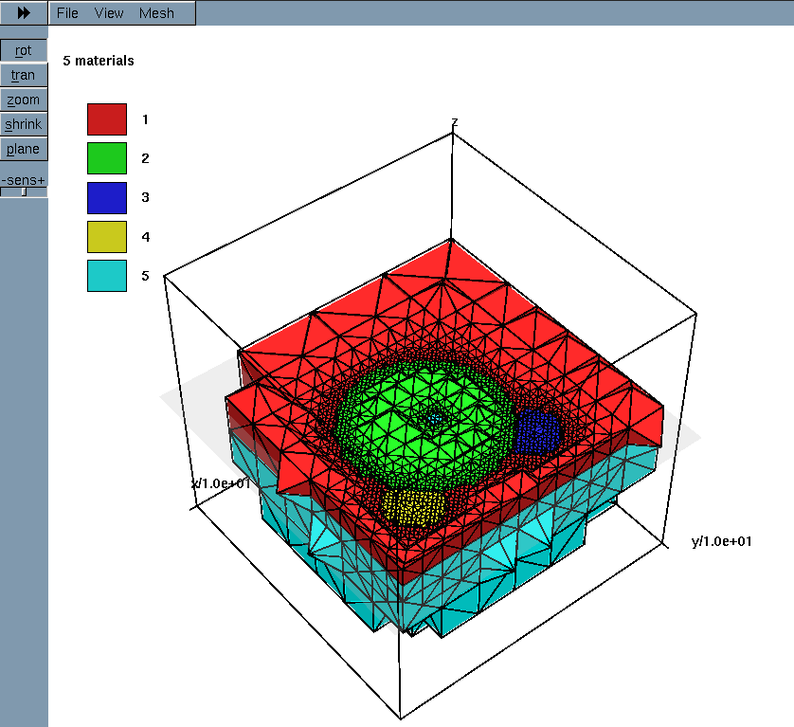
3rd Party Viewer
http://wias-berlin.de/software/tetgen/tetview.html

Slide 8
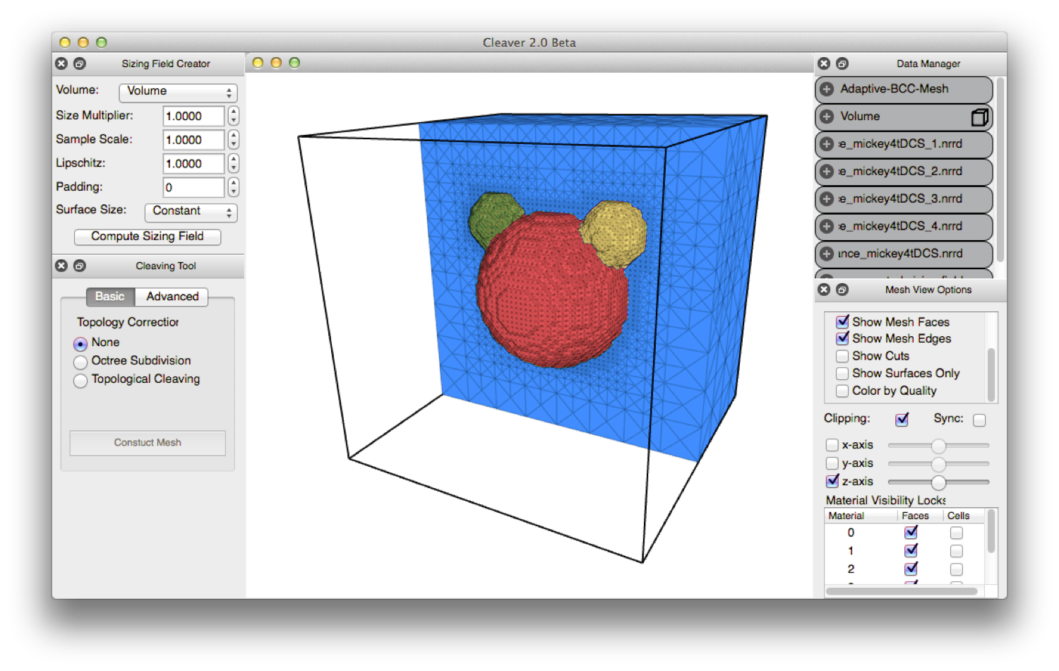
Cleaver 2

Slide 9
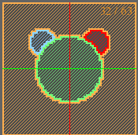
Generate Indicator Functions
Compute
Sizing Field
Generate Mesh

Slide 10
Cleaver 2

Slide 11
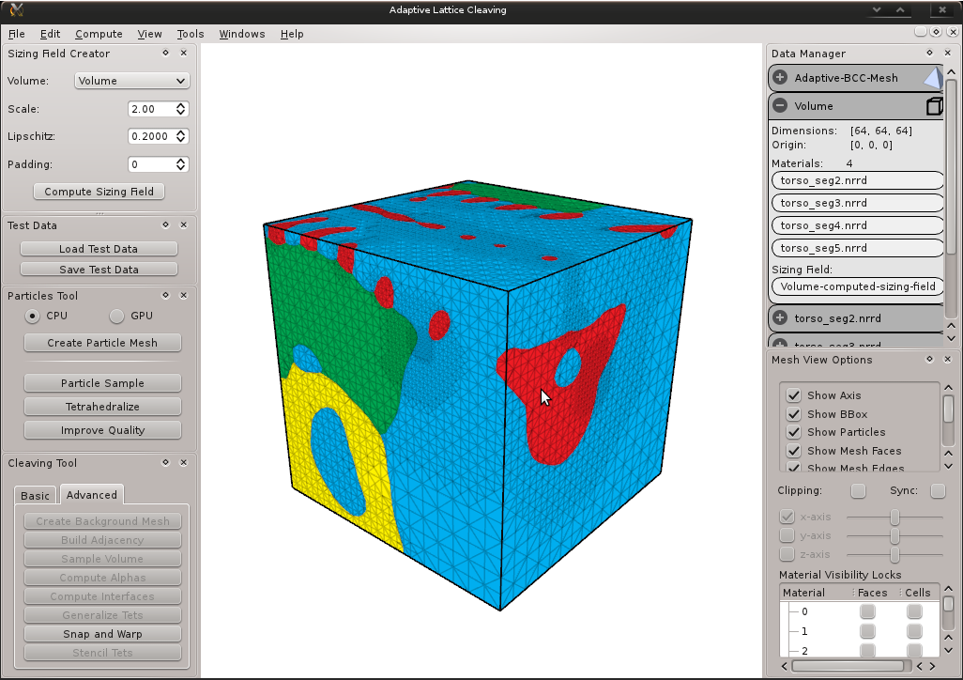

Slide 12
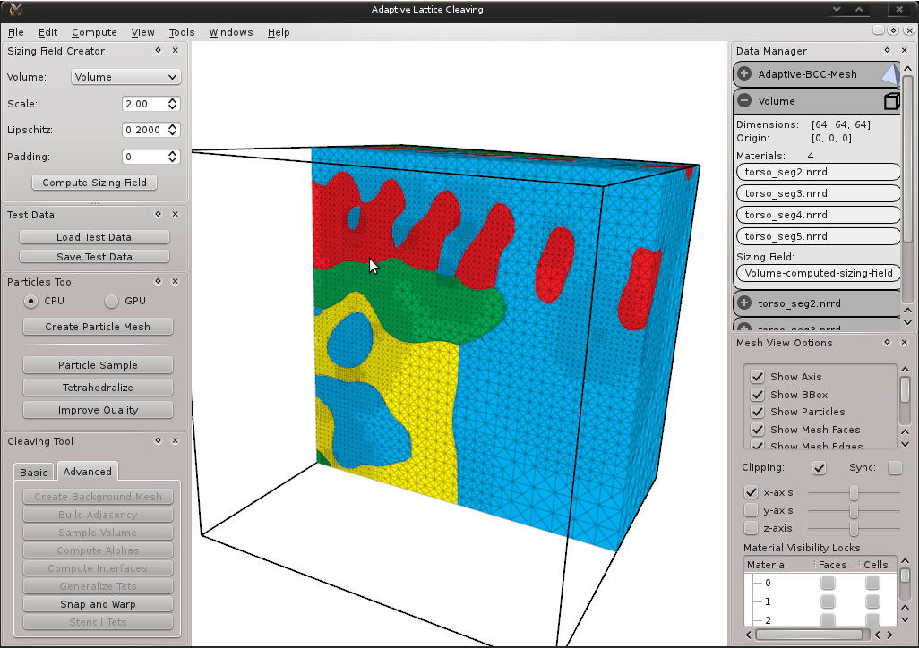

Slide 13
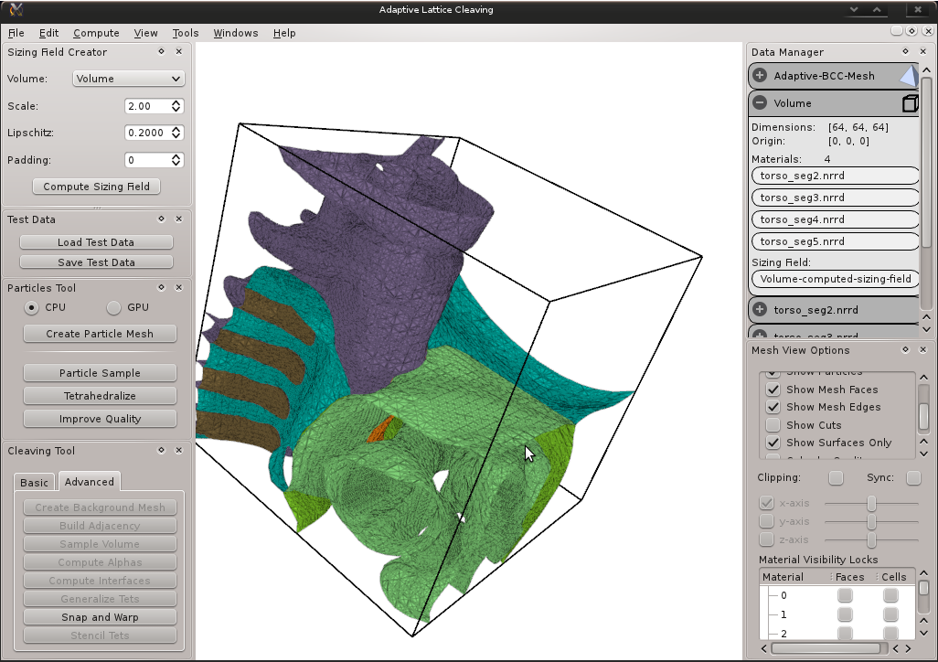

Slide 14
